Slide 1

Employee Management System for Java Full Stack Project
Under the Guidance of
Trainer Pooja Mehta Mam
Presentation by
Presented by
Miss.Shivani More
Miss.Rashmi Poojary
Miss.Shreya Jadhav
Miss.Mrunali Kante
Batch – ECA 7582

Slide 2
Contains:
Introduction
Objectives
Proposed System
Existing System
Scope of Project
Implementation tools
Screenshot of output
Application of Project
Conclusion

Slide 3
Introduction
The employee management system is a modern technique to manage the employees’ information. It gives the complete information about the employee to the management and also it helps in maintaining the complete organization-related information. The entire organization can be the employee management system in a better way. When you maintain all of your employees’ information with this application, it will help in your business development in a better way. Also, it will help in the employee’s performance. The Employee Management system helps to maintain the entire organization in a better way. The application maintains a link between the employees. Also, the management which helps in the business development.
The employee management system has many options for the users. So, the employees can access the information of the employees from anywhere and this is one of the benefits of using this application.The Employee Management System works on an online server, so it can store all of your employees’ information without any issues and will help you to manage the employees’ information easily. Also, it manages the complete company information without any issues.
An employee management system is user-friendly software and easy to use for all users without any issues. So, you will be able to use this application in a better way.

Slide 4
Objectives
This project aims to simplify the task of maintaining records of the employee of compony.
To develop an well designed database to store employee information.
Provides full functional reports to management of company.
“A continuous process that seeks to identify, measure and develop the performance of the workforce periodically” There is a fair chance that the organizational performance report has not met the expected level. Also, the existing performance management system is not enough to elevate employee performance.
Setting and defining goals to fulfill organizational objectives
Setting the right expectations for each employee – managers and employees
Setting Performance Standards and metrics to measure
Establishing effective communication channel between managers and sub-ordinate
Determining training plan.
Review the process periodically.

Slide 5
Proposed System
The proposed system is internet based system so employee can also participate in this system and track their status.
Proposed system This Employee Management System project will help the organization with the management of the information of the employees. The system will centralize the management system and will provide different options through access to data will become accessible.
The system will be based on the internet so that any user can use it from any place with ease. The Employee Management System software will make a report of each employee of the organization at the end of the month so that the organization will have information about the work of each employee. This Employee Management System will not only reduce the time but as well it will make the system efficient.

Slide 6
Existing System
In the present Employee Management System of data management, some person maintains the data manually, which required a high amount of time as there are so many people work in the organization. The organization keeps the record of all the employees in the paper which is not a secure way of maintaining the data. As there is a high amount of register in which information is stored consume a lot of space in the organization while retrieving any information from that many files consume huge time and it is not an easy process.
The records are maintained in registers.
Time consuming process.
Complicated searching, editing and updating.

Slide 7
Scope of Project
Employee Profiles: Employee will have access to their personal profiles and will be able to edit their details.
Leave Application: Complete elimination of paperwork in leave management by enabling an employee apply for leave as well as check their leave status through the system.
Project and Task Management: Assign tasks and projects to employee, assign a project team and keep track of the progress.
Recruitment process: The admin will add an employee and a employee ID will be generated and sent to the new employees email. The HR manager will then have the ability to add an employee information to the database.

Slide 8
Implementation tools
Backend Technologies:
SpringBoot
Json
MySQL
Frontend Technologies:
Spring MVC
BootStrap
CSS
HTML5
JS

Slide 9
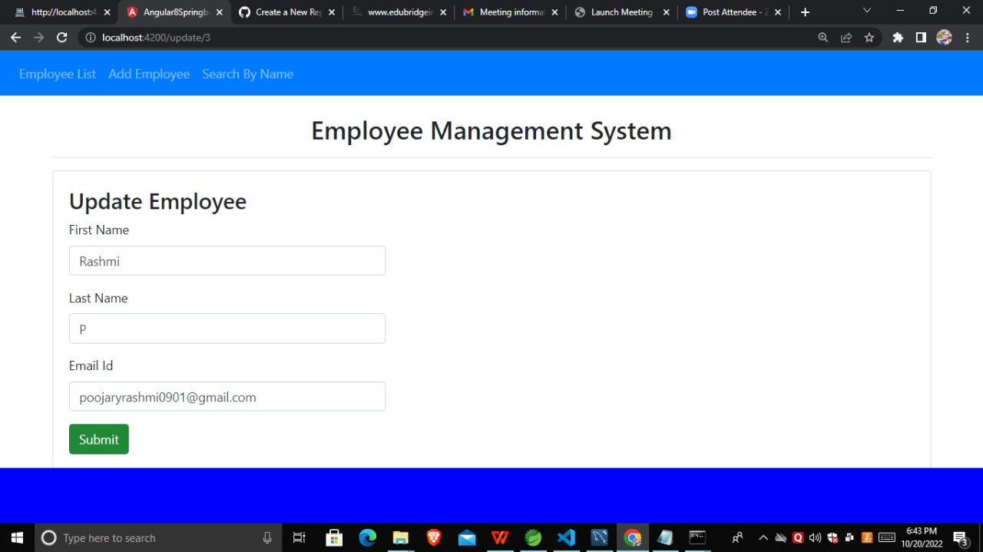
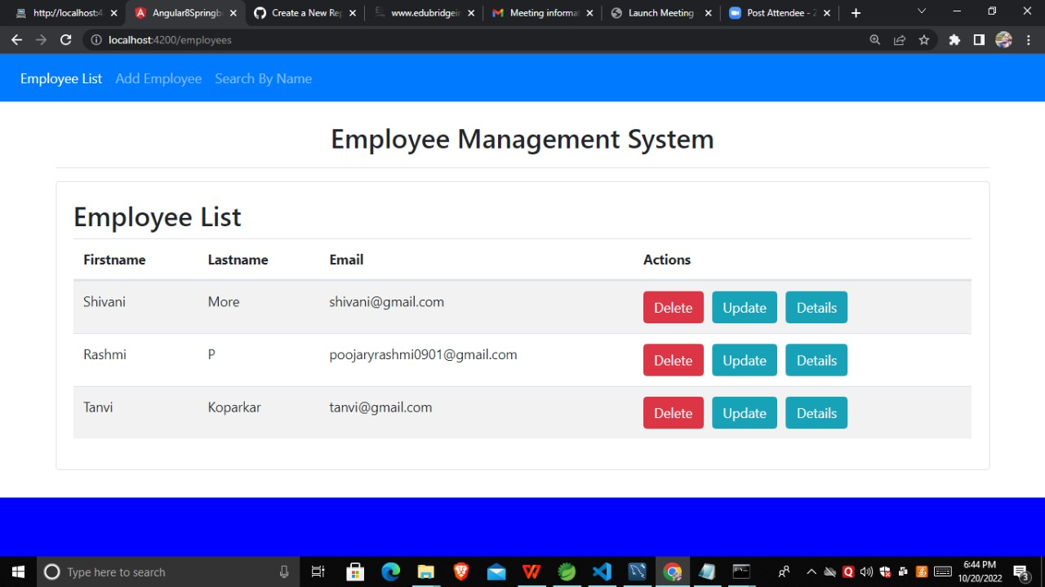
Screenshots: add employee and Employee list

Slide 10
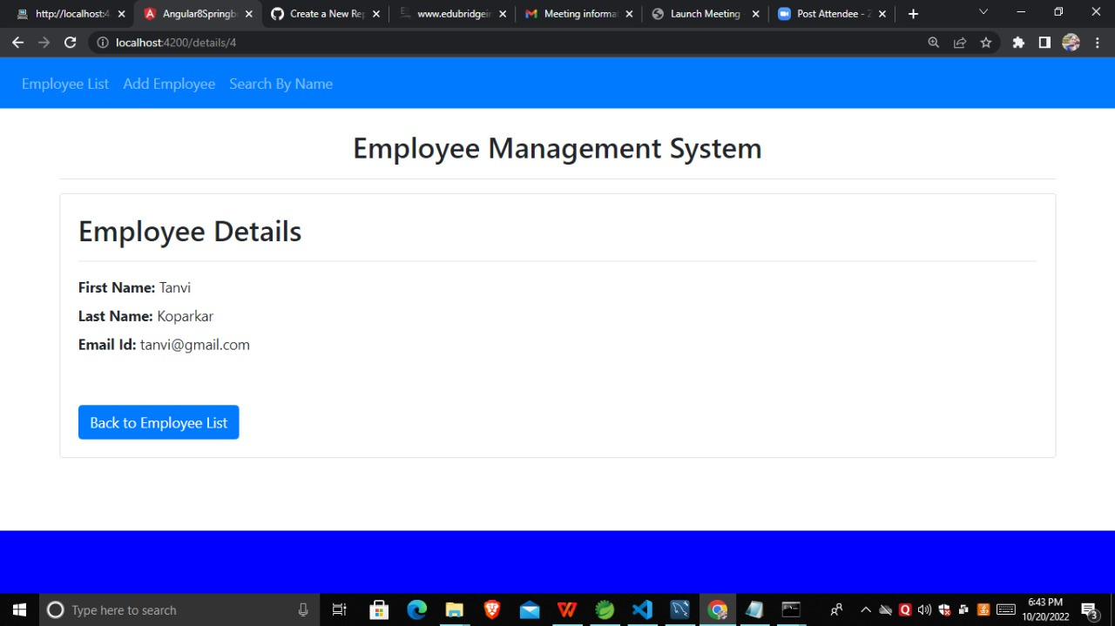
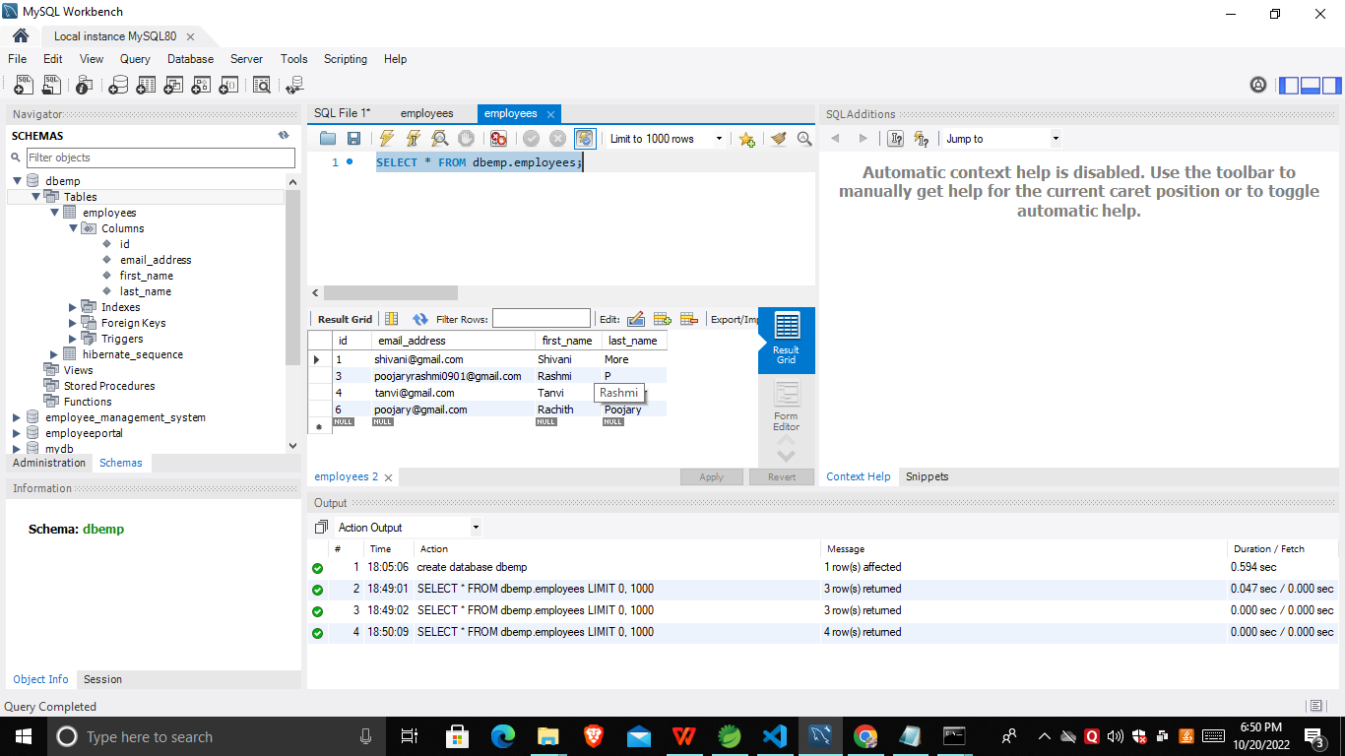
Employee details and Database

Slide 11
Application of Project
Provide Computerized system for maintaining records.
More efficient and reliable.
Less time consuming and easy to use.
Hugs data storage with less computer memory.
Avoid human errors and efforts for maintaining daily data.
Also avoids data inconsistence and redundancy.

Slide 12
Conclusion
The Results were discussed, problems faced and limitation were elaborated. Future Recommendations for the extension and improvement of the system have also been discussed as well as an assessment of achieved functionality.
The software product produced was fairly good, IT achieved most of the user requirement. The user interface is good and is very easy to navigate and even novice users can find their way around the web application .

